Slide 1
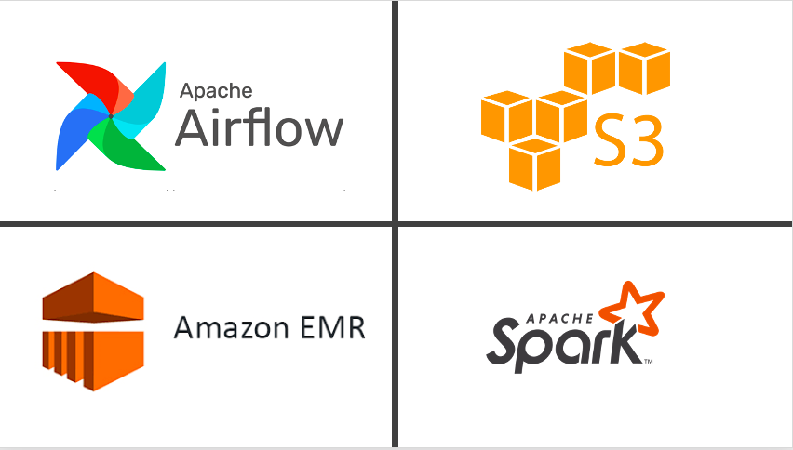









Solution Architecture
Automated Pipeline
Archive data in S3 for traceability
Flatten JSON file
Analytics Zone
Vendor 1
Optional Step –
Generate flat file extracts for vendors/third-party to fulfil on-demand requests
Open Library Data
Downloaded from the open library webstore
Refresh Hive tables with metrics calculated in previous step for end users to query the data
Run queries to extract information/metrics from the data
Ingest into staging layer
Landing S3
Data cleansing step to enable analytics
Outbound FTP S3
Database containing Hive tables
Vendor 2
Data Lake
Virtual Private Cloud

